Slide 1
Excel Advanced Data Visualization
Advanced Data visualization is a graphical representation of data by utilizing Pivot tables and Slicers, We can provide a simple and accessible way to understand our data and identify trends and outliers within our datasets.
By NIVED SUDHINDRAN

Slide 2
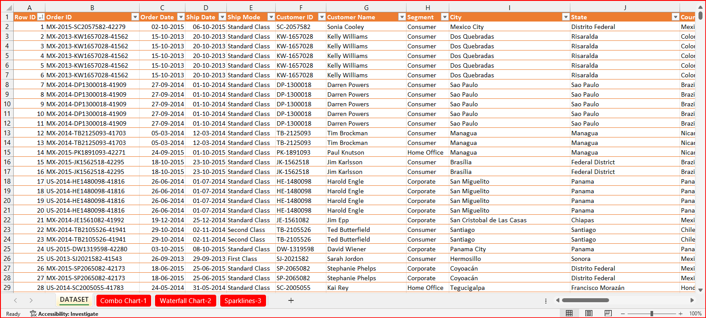
Sample Dataset

Slide 3
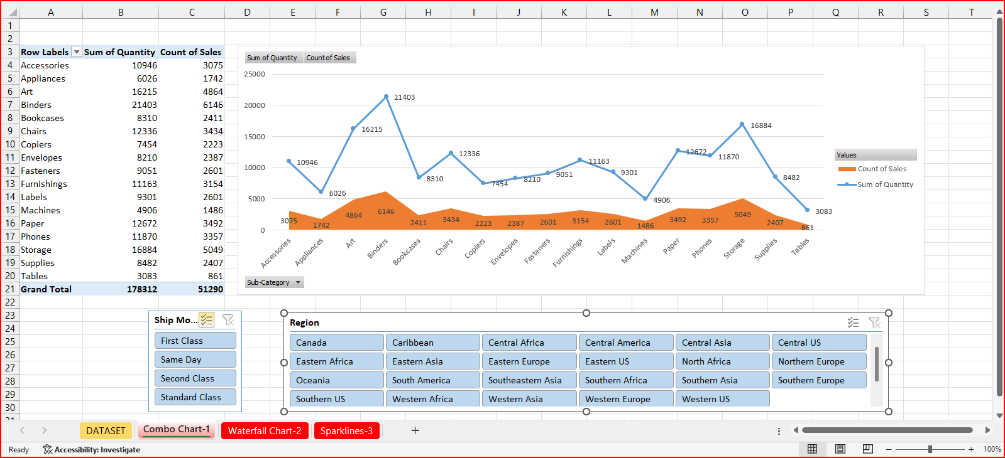
Excel COMBO charts

Slide 4
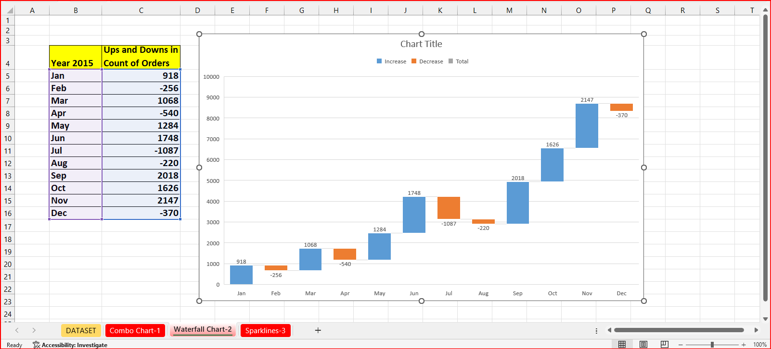
Excel Waterfall charts

Slide 5
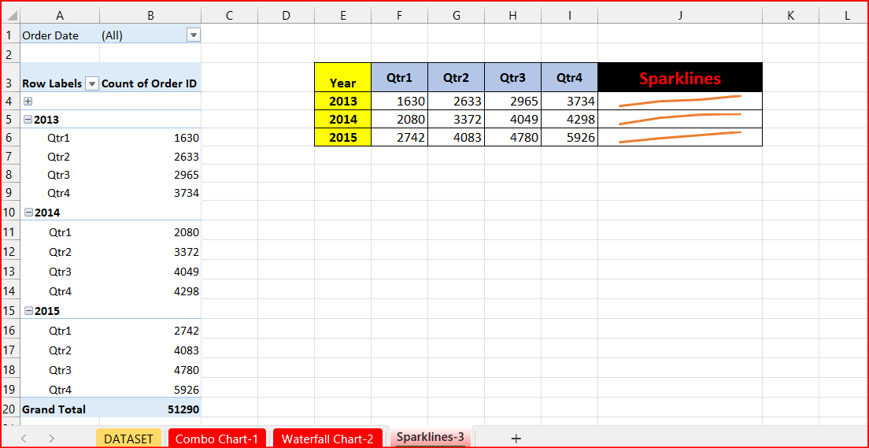
Excel Sparklines charts

Slide 6
THANK YOU

